Slide 1
Text-Based Real-Time Emotion Analysis On Cloud Service
Motivation and Application
Team Social Network Observer
ZHANG ZERU
t0925950@u.nus.edu

Slide 2


Motivation
02
We are confronting a huge number of text messages nowadays.

Slide 3

Motivation
02
Language is the root of misunderstanding. ——《Le Petit Prince》

Slide 4
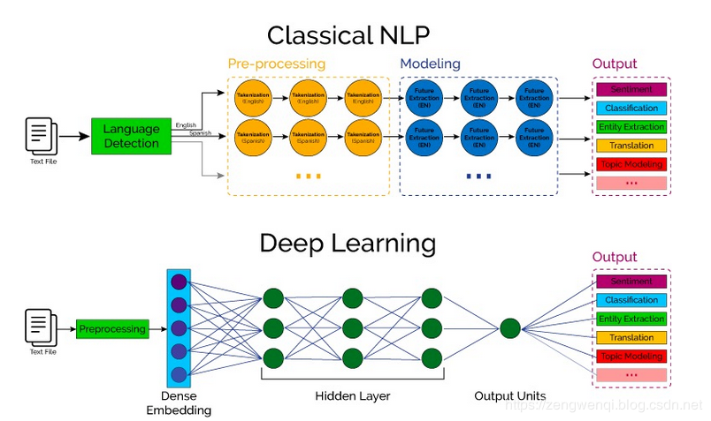
Motivation
02
Informatics and computing technology enable machine to analyze the text messages automatically in real time.

Slide 5
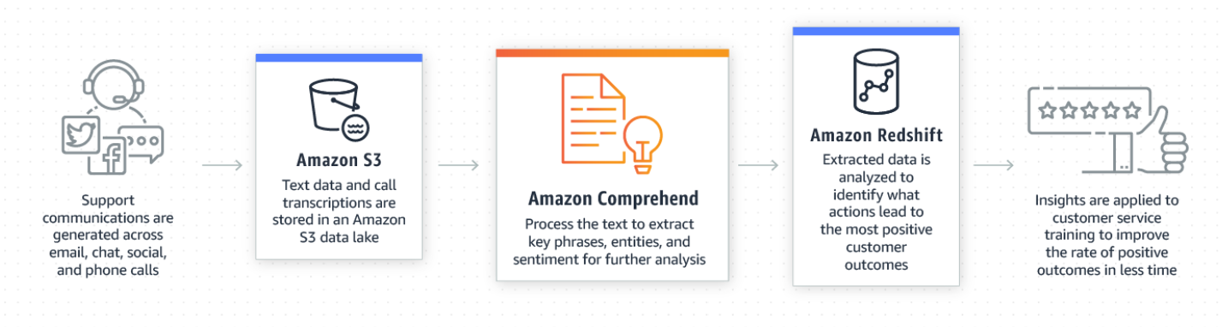
Motivation
02
HOW AWS HELPS
Amazon Comprehend is a natural language processing service
that utilizes deep learning techniques to implement text sentiment, named entities, analysis of key phrases, and topic classification of articles.

Slide 6
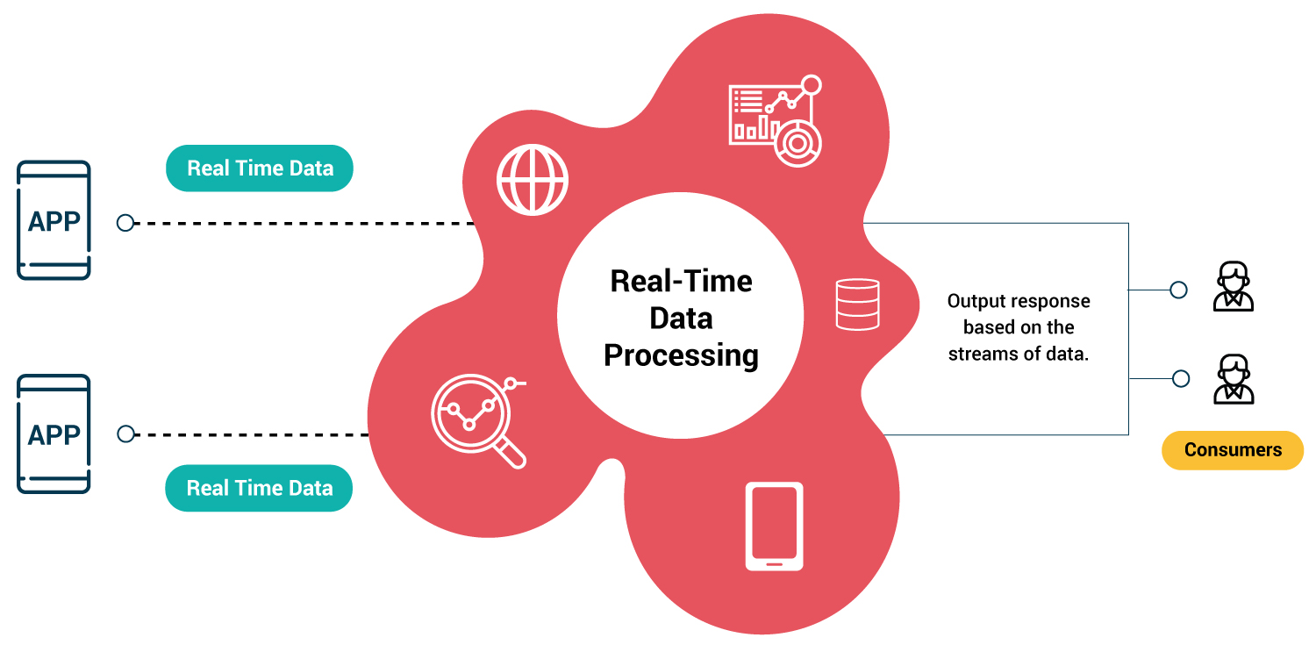
Application
02
Existing gaps in the domain to be addressed by our project.

Slide 7
Application
02
The emotional trend of participants can be used to judge or mine the value of the topic, so as to analyze the relevant public opinion.
Emotion trend of stock market
Application
Customized service from e-commerce platforms
Detecting insulting sentences in conversations

Slide 8


Application
02
The market targeted and how our project will disrupt it.

Slide 9
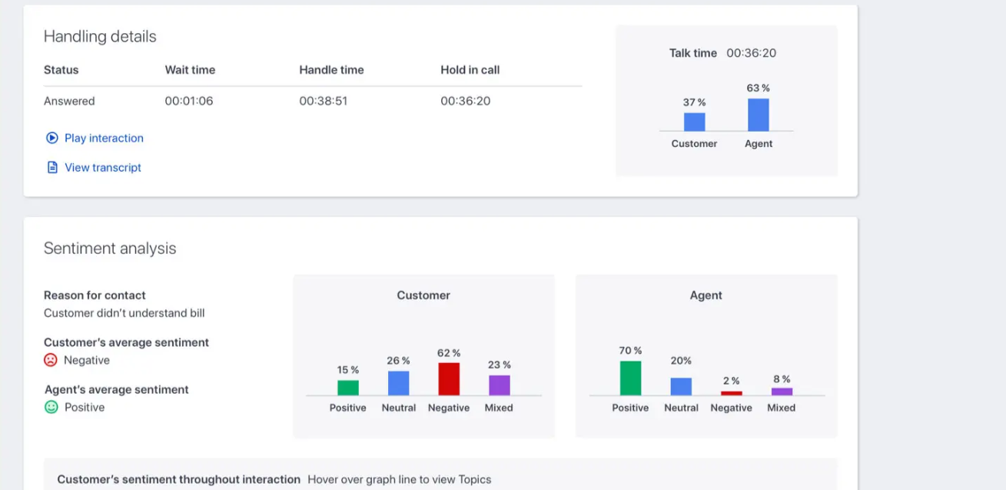
Application
02
The market targeted and how our project will disrupt it.

Slide 10
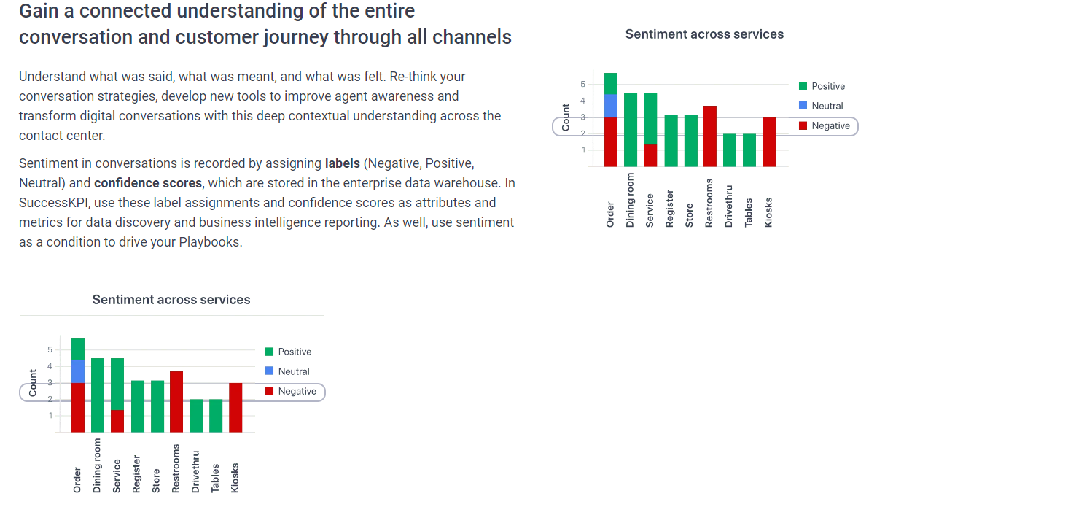
Application
02
The market targeted and how our project will disrupt it.

Slide 11
THANK YOU

